Slide 1

Document version: CURRENT
Document Owner: Mike Savage <msavage@redhat.com>
Current Recommended Version: This document
Content Owner: The user responsible for each slide’s content is marked in the speaker notes
See: Contributors page
Needs Review
This document follows the ABCD Versioning Notation Lifecycle

Slide 2
Red Hat Infrastructure Standard Adoption Model (RH-ISAM) 2023
How to use this deck:
This deck is ideal for SA, SSP, SSA role as a secondary conversation
Make a copy of this deck
Customer is looking for more detail w.r.t. RH-ISAM.
Initial Technical Level Overview
Next Steps:
RH-ISAM Deep Dive (external) by Account SA or RHEL SSA
RH-ISAM Service Offerings

Slide 3
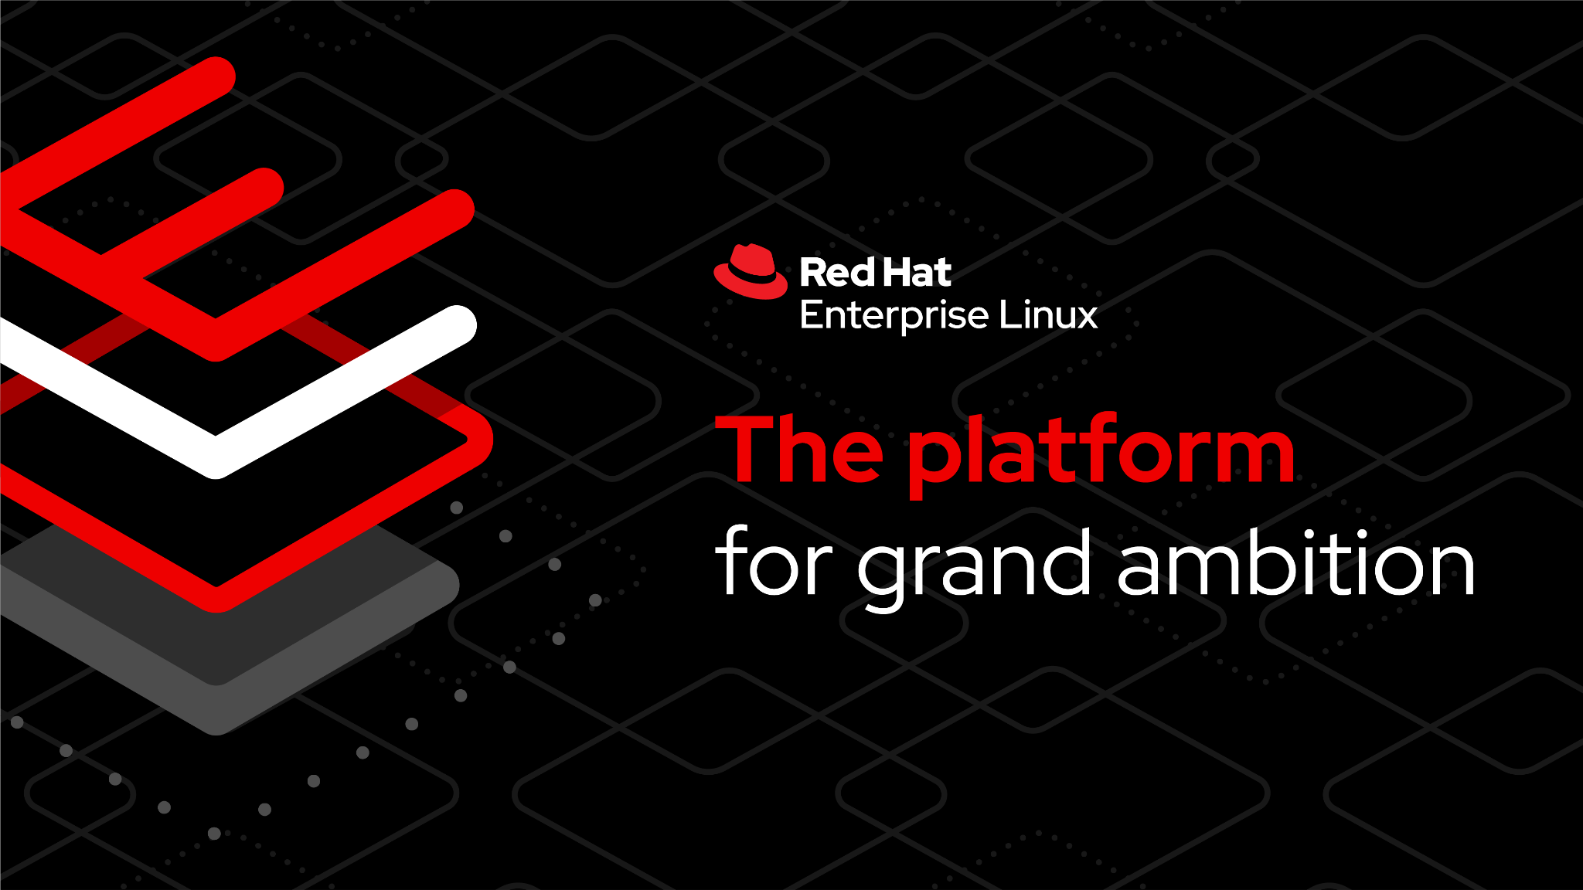

Slide 4
The Red Hat Infrastructure Standard Adoption Model
[v1.3 Current]
General Overview
Paul Armstrong
Senior Principal RHEL Architect
Mike Savage
Senior Principal Chief Architect
Notes:
[Content Owner]: Paul Armstrong

Slide 5

Red Hat Infrastructure Standard Adoption Model
Red Hat Infrastructure Standard Adoption Model
WHAT ARE WE TRYING TO ACHIEVE?
Aging and end-of-life operating system platforms present serious operational and security challenges to our customers. This approach assists customers in their need to modernise their platforms without disrupting critical business while adopting recommended practices and workflows.
It is built on the idea of a Standard Operating Environment extended to use IaC methods.
WHAT IS THE RED HAT INFRASTRUCTURE STANDARD?
This workload centric approach is to assist customers with the following:
Run workloads on Red Hat Enterprise Linux at scale in a hybrid multi-cloud environment.
Adopting Red Hat recommended practices and workflows.
Streamline Operations by standardising on workloads on Red Hat Enterprise Linux.
Allow for modernization of workloads by converting workloads to RHEL and upgrading in-place.
Reduce Technical Debt, Operationalise Security and Compliance, Automate delivery and maintenance.
Notes:
[Content Owner]: Martijn Ten Heuvel, Paul Armstrong

Slide 6








Personas involved in the RHIS Adoption Model
Red Hat Infrastructure Standard Adoption Model
“”
“”
“”
“”
We need to manage, maintain and automate my Linux platforms to improve my quality of services.
We have to be able to manage more systems and comply to complex standards. We need to standardize and automate to do so.
We cannot risk to be exposed to security risks. Systems that are not supported are a big risk.
We have requirements to at any time have a up-to-date, fully and commercially supported estate.
Linux Admin
Linux Admin Manager
Chief Information Security Officer
Chief Information Officer
Notes:
[Content Owner]: Martijn Ten Heuvel, Jelke Dijkstra
The personas are here to identify where we are going to be able to position the solution

Slide 7

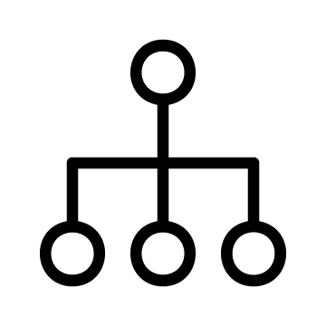









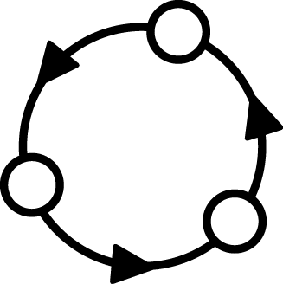
Adopt Red Hat Infrastructure the right way!
Red Hat Infrastructure Standard Adoption Model
Standardise intelligently and automate to enable responsive IT
Fragmented ‘approach’ |  | Snowflakes Tool-du-jour Manual, error-prone | Documentation gaps Tribal knowledge Silos of expertise | Legacy deployments Technical debt Static images
Standard Operating Environment
Standardize
Automate
Iterate
Notes:
[Content Owner]: Paul Armstrong
Linux Adoption is no different than any other operating system. It starts with 1 guy deploying 1 server and figuring out how it is supposed to work. Then they create a second system and connect them on a network. Now they have to figure out all the things that make systems talk and play nice with each other on a network.
Authentication, Name Services, Time Services, etc.. all the things that are there before we even think about putting an application on a system.
Then we have to keep it up to date as we work with it, back it up, configure it.
All this is pretty simple with 2 machines and not very labour intensive.
What happens when we get to 10? 100? 1000?
Each team can take their own approach to these challenges. Then when they come together, we get standards that, well, aren’t so standard.
Why can’t I create an infrastructure like a cloud provider!... Well you can. There are some steps we need to take though.
Cloud providers scale, because of automation. They can only automate because they are highly standardized. *This* is the way we do “X”
So, we need standardization before we can automate.
Its not done, because its never perfect. Perfect is the enemy of Good.
So we Iterate. What does this start to look like… What are some of our blockers..

Slide 8

Standard Infrastructure Deployment
Red Hat Infrastructure Standard Adoption Model
What, how, and why
 | Challenge |  | Approach |  | Benefits
Fragility
Systems are specified and built with inflexible scripts and/or complex procedures that make reuse and revision difficult
Refactor
Redefine systems in functional layers and reusable elements for a component-based approach to Standard Operating Environment
Flexibility
Update components independently and recombine easily to streamline SOE definition and maintenance
Variability
New patches, updates, and configurations are applied piecemeal across the environment multiplying inconsistencies
Standardize
Codify content delivery, configuration, and lifecycle management with tooling and monitoring
Efficiency
Easily monitor and manage drift, versioning, and compliance with system-wide or individual remediation
Complexity
Manual processes and complex scripts lead to errors in production that are hard to isolate and resolve.
Automate
Specify system build and configuration in human readable language and validate delivery in lab environments.
Reliability
Rapid and repeatable provisioning of proven production systems, in isolation or en mass, with trusted automation
Notes:
[Content Owner]: Paul Armstrong
One of the concepts that we will discuss in that of the Standard Operating Environment. In a nutshell, it encompasses the content that we allow on our Linux systems, but it also helps us define how and when it gets there. One of the challenges that we at Red Hat see in many customers is that the way in which systems are spec’d out and built is so customized, that it is essentially a monolith. Once it is built, maintenance, revision and reuse are next to impossible. Also, different parts of the organization may have implemented different standards, or generated exceptions to meet deadlines, etc.. If we take the time to redefine the systems in terms of the functional layers of the software stack we can drive out the necessary components The refactoring will revive the flexibility in our environment, allowing more easy recombination and streamlining maintenance.
As we refactor the components of the Operating Environment, we can drive standardization by codifying content delivery, configuration, lifecycle and compliance through tooling. The standards drive efficiencies
We need to show both the process and the architecture… the process is our consulting methodology and agile process and our architectures are tested in the field with some of our largest and most valued customers.
People -> Innovation Lab will train them…

Slide 9
Where does the RH-ISAM fit in the Strategy?
How does the Red Hat Infrastructure Standard Adoption Model fit into the strategic programs that Red Hat engages with their Major customers in?
Notes:
Storify

Slide 10
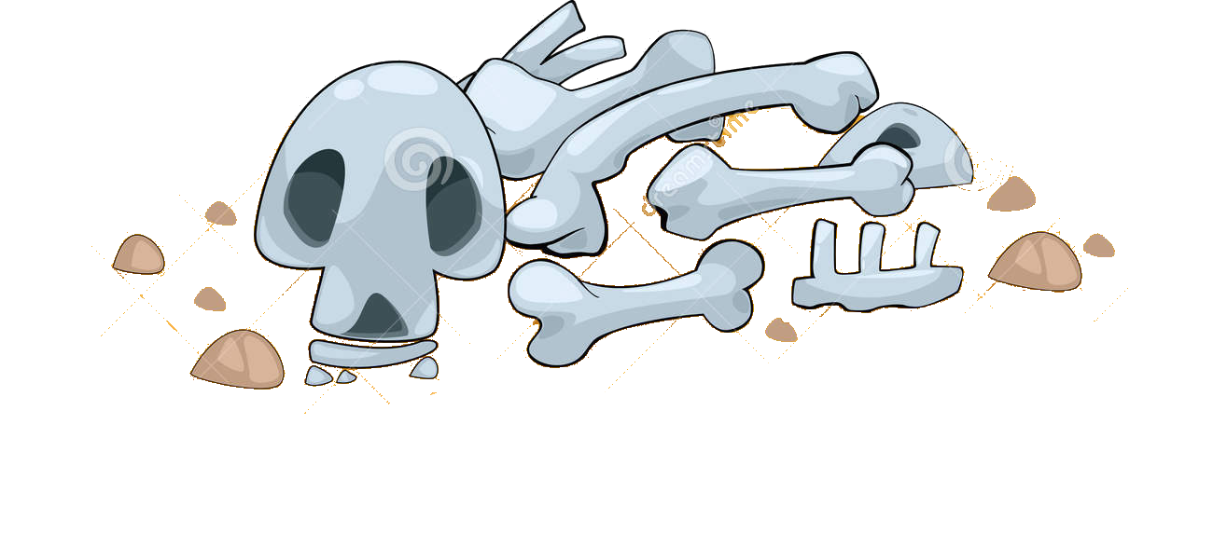
Cloud Native Adoption Curve
Entering at the wrong point in the continuum == failure
Red Hat Infrastructure Standard Adoption Model
RH-ISAM
Network
Automation
Secured Supply Chain
IaC
Builds
Multi-Cloud
Server Provisioning
Zero Trust
GitOps
CI/CD Scaffolding
Return on Investment
In-Place Upgrades
OpenShift
Enterprise Pipelines
Migration Factories
OpenShift + ACM + ACS
Developer
Workstations
Container Dev Environment
Entry Automation | Infra automation | Container Development | Container Platform Essentials | Workload Intake Acceleration | Platform Services | Advanced Capabilities | Regulatory Support
Time
Adapted From: Flight Path End to End by Adam Seeley and Bob Mader
Notes:
[Content Owner]: Paul Armstrong
Adapted from Flight Path End to End by Adam Seeley and Bob Mader

Slide 11
Capability Matrix for Flight Path
Red Hat Infrastructure Standard Adoption Model
Inflection Point
Platform Prep
Platform Delivery
Overall maturity increases up and to the right Copy this slide and use the colour fill key below to generate your map.
CI Framework
RH-ISAM
Observability Pub/Sub
Security Services Provisioning
Platform Workflow
Declarative Infrastructure
Operator Certification
Chargebacks
Automated Governance
Network Provisioning
Runbook Automation
Platform Security
Sidecar Integration
Resiliency Validation
Application Lifecycle Automation
Platform Bill of Materials
Storage Provisioning
Provisioning Mgmt
Prod-like Sandbox
Secrets Management
Build Pipelines
Disaster Recovery / Active Failover
FinOps
Software Bill of Materials
Compute Provisioning
Version Control
Single Containers
Storage/Network integration
Deployment Integration
Fleet Management
Zero Trust
Custom Policy Enforcement
Config Mgmt
Automation Workflow
Dev Workstations
Workload Analysis
Image Ingestion
SRE Patterns
Service Mesh
Reg. Auditing & Reporting
Foundational Automation
Infrastructure Automation
Container Development
Container Platform Essentials
Workload Intake Acceleration
Platform Services
Advanced Capabilities
Regulatory Support
Key:
Under Performing
Rudimentary
Developing
Acceptable
Advanced
Leading
Adapted From: Flight Path End to End by Adam Seeley and Bob Mader
Notes:
[Content Owner: Paul Armstrong, Mike Savage]
Adapted from Flight Path End to End by Adam Seeley and Bob Mader
This slide represents the Stages for the Flight Path journey and the capabilities needed within the organization infrastructure in order for that stage to be considered successfully completed. This is not to imply that all of the capabilities in each stage must be a leading level before proceeding to the next stage but rather a measure of overall capability and likelihood of success. The goal of the chart is to allow the leadership team to gauge current overall success of the effort by having stakeholders estimate capability across the teams that make up the effort.
Copy this slide for the initial review of capabilities and set the fill colour of each capability to create a capability map/matrix. At each subsequent review copy the previous reviews map and update it for the current review to generate a timeline of success.

Slide 12
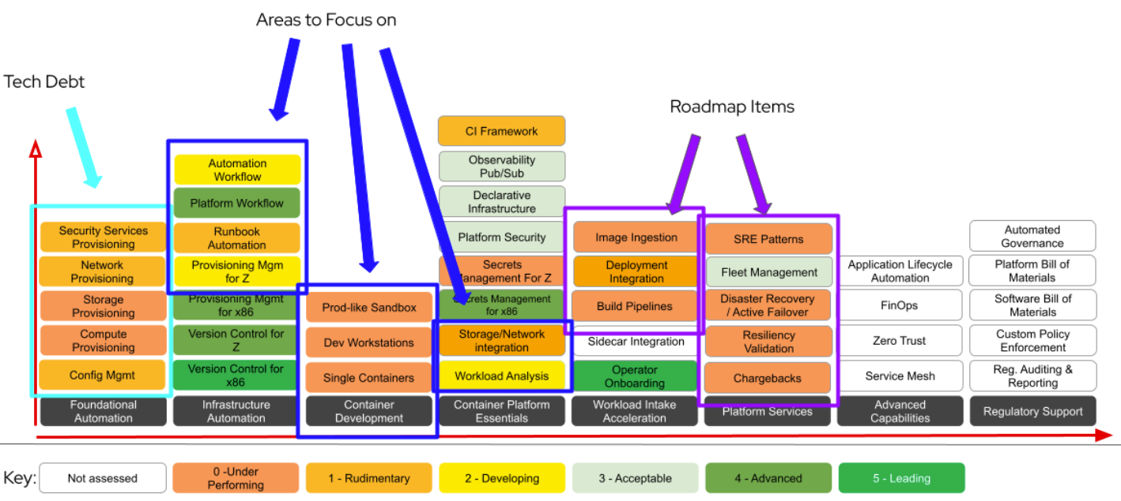
Red Hat Infrastructure Standard Adoption Model
FlightPath Journey - Customer Example

Slide 13
Combining Flight Path with the Curve
Build-up of RHEL, Ansible and OpenShift platform capabilities that are used to accelerate application adoption.
Red Hat Infrastructure Standard Adoption Model
RH-ISAM
Network
Automation
Secured Supply Chain
Prod-like Sandbox
IaC
Builds
Security patching
Multi-Cloud
Server Provisioning
Product upgrades
Zero Trust
Dynamic scaling
GitOps
CI/CD Scaffolding
Return on Investment
Ephemeral environment
In-Place Upgrades
Container Dev Environment
OpenShift
Automated deployments
Developer
Workstations
Enterprise grade environment
Configuration Management
Configuration
Non-Production
Lifecycle Management
GitOps
Production Environments
Self Service
Scale
Entry Automation | Infra automation | Container Development | Container Platform Essentials | Workload Intake Acceleration | Platform Services | Advanced Capabilities | Regulatory Support
Time
Adapted From: Flight Path End to End by Adam Seeley and Bob Mader
Notes:
[Content Owner]: Paul Armstrong
Adapted from Flight Path End to End by Adam Seeley and Bob Mader

Slide 14
Red Hat Infrastructure Standard Adoption Model
Red Hat Infrastructure Standard Adoption Model
A modular framework to support customer infrastructure modernisation - click on components for more information
Migrate to RHEL
Analysing workloads on non-RHEL platforms (inc. legacy UNIX, Windows, +Linux), creating a migration strategy, replatforming candidate workloads on RHEL using a migration factory approach.
Convert to RHEL
Analysing and converting in-place rpm based operating systems to RHEL.
This allows in-place upgrade to eliminate technical debt.
Upgrade to RHEL8 or 9
Analysis and in-place upgrading servers running older versions of RHEL to RHEL8 or RHEL9.
Modernize Virtualization
Deploy New Virtualization Platforms and migrate workloads onto it.
Modernize Application Delivery
Analysis and migration of applications running any operating system to a standard methodology
Deliver All Standard Workloads through Automation
Plugable Solutions
at least one + Contribute
Implement the Red Hat Infrastructure Standard Platform *
Required :building a secure, stable, manageable, automated RHEL platform to scale workloads on
Foundational
Navigate to the Red Hat Infrastructure Standard
Engage with Red Hat to fully determine requirements, operational readiness.
* This component is mandatory unless the customer already has a RHEL Standard Operating Environment in place.
Notes:
[Content Owner: Martijn Ten Heuvel and Paul Armstrong]
List:
Migrate to RHEL document
Convert to RHEL document
Upgrade to RHEL9 document (DONE)
Migration pilot for OSP (openstack) - does that still have a value?
Add a new box: migrate to OCP virtualization, find the virtualization approach build.
Same with HANA
SOE Provisioning also is a link.

Slide 15
A Standard Operating Environment
Red Hat Infrastructure Standard Adoption Model
What is a Standard Operating Environment and how will developing one benefit my business
Notes:
[Content Owner]: Paul Armstrong

Slide 16
What is a Standard Operating Environment?
Red Hat Infrastructure Standard Adoption Model
A model for the conditions under which we control our machines, systems and processes.
Value is created when we can refactor to a short, discrete list of SOEs using select tools designed to work together in well-defined processes, providing a path to integrated Automation.
A primary goal of the RH-ISAM project is to describe the components used in, and provide automation for, delivering infrastructure to ease and codify the building and maintaining of SOEs for Red Hat Enterprise Linux environments.
Notes:
[Content Owner]: Paul Armstrong
Break it down - the Oxford Dictionary defines these terms:
Standard - a model or norm for comparative evaluation
Operating - the control of the functioning of a machine, system, or process
Environment - the conditions under which an entity (machine, system, process) operates
We can have as many Standard Operating Environments as there are machines, systems, and processes. The value comes when we refactor these models so that we can start from a short discrete list of SOEs and well defined tools and processes that allow us to automate delivery.

Slide 17
But Why an SOE?
Red Hat Infrastructure Standard Adoption Model
What Hyperscalers do isn’t magic.
Efficiency
Simplified Onboarding and Support
Enhanced Compliance and Security
Healthy Patterns sustain Automation
Standardization simplifies and streamlines delivery and operations.
Standardization reduces volume of documentation, special procedures, and allows easier drift detection.
Infrastructure operations become more responsive as a result
Standardization reduces silos, tribal knowledge and allows for deeper knowledge to develop in teams
Standardization helps new-hires get to day2 faster
Operations and Helpdesk throughput increases
Standardization allows for faster anomaly detection. Configuration, behaviour and logging exceptions outside the norm are more easily spotted.
Standardization helps teams move beyond the checkbox and deliver on cybersecurity maturity
Standardization is a precursor to sustainable automation.
Delivering on proven design patterns allows for the extension of automation process beyond simple configuration and extend to systems generation and event driven response
These are only a few of the benefits organizations realize… also, easier development, rapid solution delivery, stability, etc..
Notes:
[Content Owner]: Paul Armstrong
When dev ops models are discussed they tend to focus a lot on the developer side of the model. The standard operating environment is critical for all those elements that run on top. Developer build systems, orchestration systems, production system creation and testing – all the elements that create the environment on which a devops model runs.
Each Standard Operating Environment model has a set of conditions that include: System content that is required / allowed, system configuration that is required, security configuration, deployment processes, application or runtime configuration, management processes, maintenance process/workflows, monitoring, logging, reporting, revision/recycling/retirement, etc..

Slide 18




The Business Value of RHEL Standardization
Articulating the Value of Automation + RHEL SOEs
Consistently build and test in the same environment, accelerating delivery for AppDev
HW and SW vendor certs extend mkt reach
Platform ubiquity - RHEL anywhere, any cloud
Streamlined management at scale, across environments
Automated identification and remediation of vulnerabilities
Predictive analytics that turn break-fixes into scheduled actions
Budget
OpEx
Revenue
AppDev productivity
NPS
Market share
TANGIBLE
Revenue Growth
Cost Optimization
Productivity
TOP LINE
BOTTOM LINE
Strategic
Goals
Risk Mngmnt
Security posture & stability
Remediation
Downtime
Innovation
Turnover
Burn-out
Largest catalog of certified partners and ISVs
Integrations with fleet management tools
Toil reduced through standardization
Power of Open Source community
Secure software supply chain
Automated detection of config drift
Faster tracking of system patch status
Gov and public sector certifications
Audit reports generation
INTANGIBLE
*includes Insights
Notes:
[Content Owner]: Mike Savage
Automation of Standardized RHEL Operating Environments unlocks these business objectives!
The Value Map for RHEL aligns to the same four quadrant view we explored in the previous slide, but you will notice has specific details regarding the technical solutions to business value, as well as measurable business impact metrics, like boosting productivity. If we were to orient ourselves in this map, and look at Cost Optimization for example, the KPIs are directly related to aspects of the solution that unlock them.
We understand the power of RHEL, but it can be difficult to articulate this to non-technical stakeholders, and you should leverage this value map in your conversations with your customers.
The intent of this four quadrant slide, specific to RHEL is to enable you to become a trust partner that offers technology to directly affect your customers business performance.
By understanding what your customer personas value, and speaking directly to those objectives, you will demonstrate credibility in demonstrating the internal and external factors that impact their business, and can supplement this messaging by demonstrating examples of where we have worked with “like” customers implementing best in class technology solutions to help them grow and operate more efficiently. The technical solution enablers in the quadrants further illustrate how Red Hat can help deliver on the desired business outcomes, and helps your customer understand why RHEL is important to their business.
Now let’s take a peek at how the VITO toolkit to help you customize your business value messaging of RHEL to your customers, and uplevel your customer conversations around Expanding Workloads to the Cloud.
Strategic - CEO
Revenue - LOBs
Cost - CTO/CIO
Risk - CISO/CFO

Slide 19
The Tools We Use
Red Hat Infrastructure Standard Adoption Model
A quick introduction to the elements of the
Red Hat Infrastructure Standard
Notes:
[Content Owner]: Paul Armstrong

Slide 20
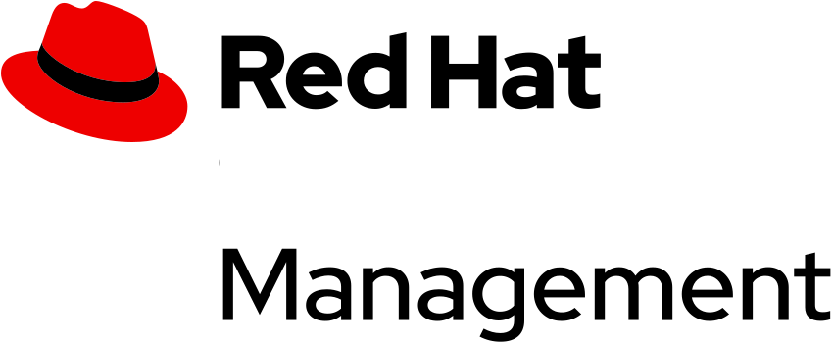

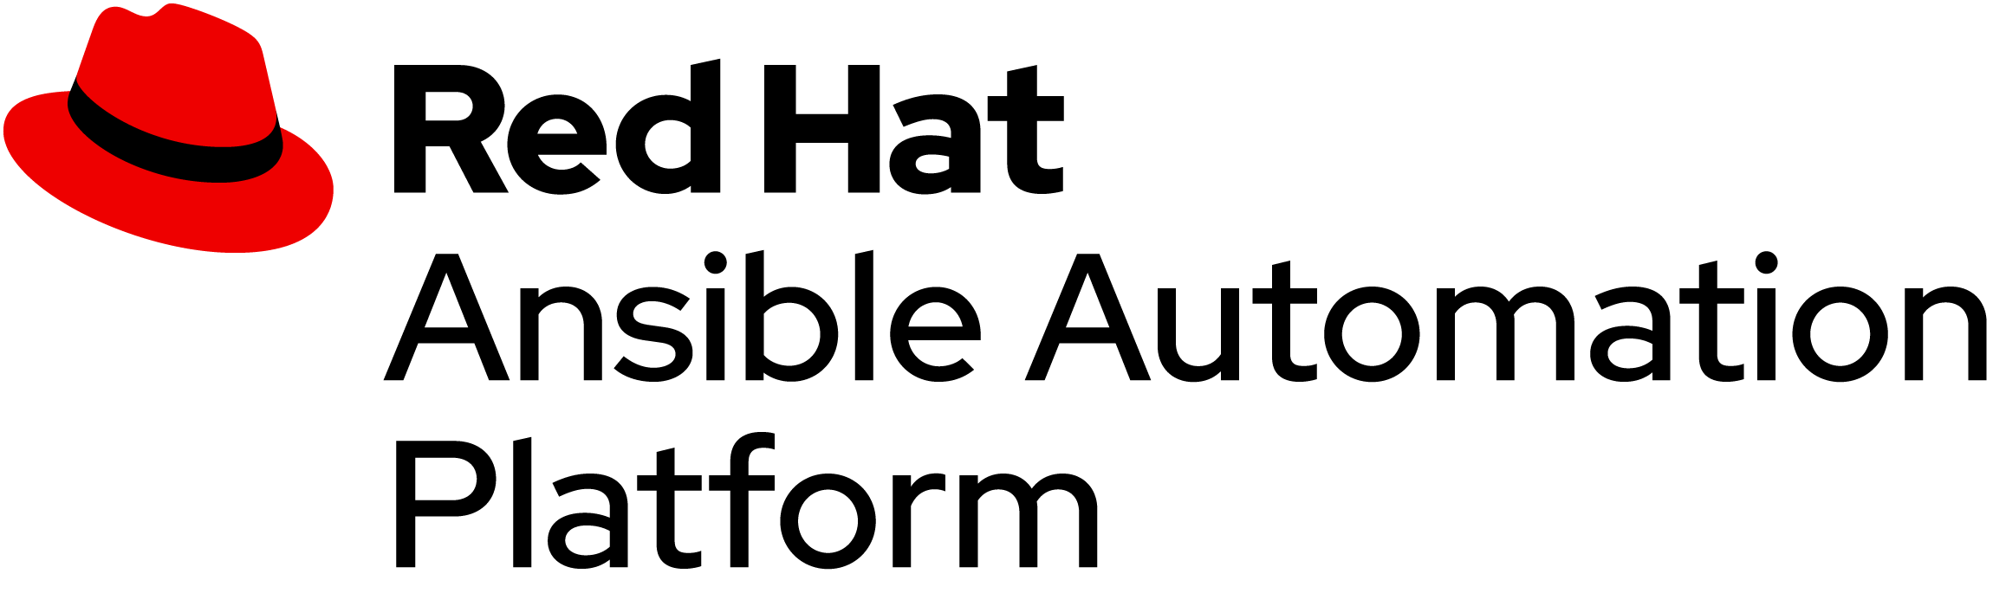



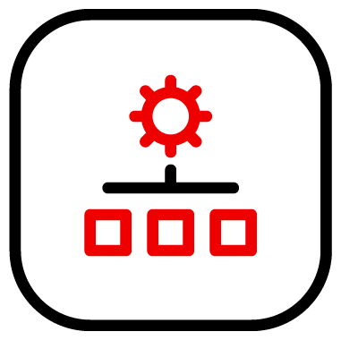

Red Hat Management Portfolio
Red Hat Infrastructure Standard Adoption Model
Identity
MANAGE LINUX IDENTITY AND POLICY
Single Sign-On, sudo, RBAC, HBAC, SELinux Policy, identity mapping, native AD Integration.
Included with Red Hat Enterprise Linux.
FLEXIBILITY TO MANAGE RED HAT ENTERPRISE LINUX
Secure software supply chain and content lifecycle on-premise or in the cloud with Satellite and Red Hat Hybrid Cloud Console
AUTOMATION FOR EVERYONE
Simple, Powerful, Agentless
Cross Platform
Systems, Network, Storage, Cloud
Human Readable
PREVENT CRITICAL ISSUES BEFORE THEY OCCUR
Red Hat “Insights” Included with Red Hat Enterprise Linux.
Red Hat Hybrid Cloud Console
Red Hat Image Builder
Notes:
[Content Owner]: Paul Armstrong
These are our core tools.

Slide 21



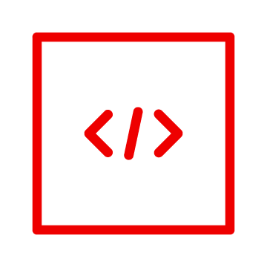


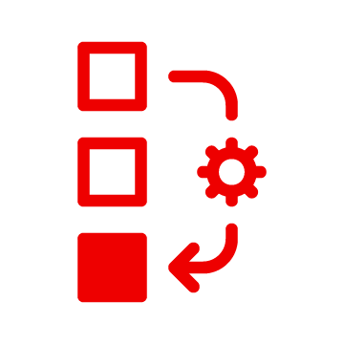










Security features of Red Hat Enterprise Linux
Red Hat Infrastructure Standard
Configuration Data Code Checklists
Blueprints
+
RHEL
+
Physical Virtual Cloud Instances
Hardened Patched
Current
Applications and Base OS
Life is Better with RHIS™
Infrastructure Standard
Build
Test
Release

Slide 22








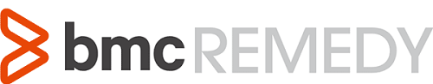

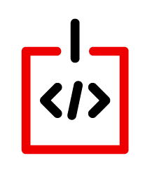






RH-ISAM in a Hybrid Cloud Deployment
Red Hat Infrastructure Standard Adoption Model
Red Hat Infrastructure Standard
Common Code and Process Across All Environments
Red Hat Hybrid Cloud
Services
Security/SSO
Lifecycle
Automation
Compliance
Configuration
Native AD Trust
Data Center 1
Data Center 2
Cloud 1
Region 1
Cloud 1
Region 2
Cloud 2
Cloud 3
Notes:
[Content Owner]: Paul Armstrong, Mike Savage
Abstracting Differences in the various data centers and cloud delivers Consistent Process and Reduces the impact of Change.
Automation can define processes to deliver content; define and deploy systems; check compliance and manage configuration; all by simply changing the variable values and not the underlying code.
As an example, using image builder we can define a cloud image from RHEL8 built from a Satellite content view. We can deploy that to AWS, Azure, VMware or OpenStack based simply on specifying the target connection information. We can then have Satellite deploy the image, again, by simply specifying the Compute Resource. Ansible can manage the host configuration no matter where it resides. When the image is deployed and configured for IdM integration, all the centralized policy is implemented on the system, again simply and easily.

Slide 23
Deploying the Standard Operating Environment
Infrastructure
Red Hat Infrastructure Standard Adoption Model
Notes:
[Content Owner]: Paul Armstrong

Slide 24
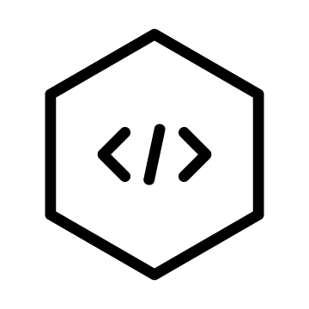


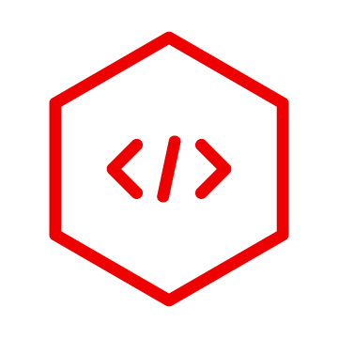
Provisioning SOE Systems
Red Hat Infrastructure Standard Adoption Model
Curate Content
All of these services are delivered across a Hybrid Cloud Environment using standardized workflows
Identity Enrollment & Authentication
Pre- and Post-Provisioning Configuration
Provisioning Automation
Maintenance Automation
Compliance Definition, Reporting, Remediation
Vulnerability Analysis, Remediation
Standardized Image Delivery
Kubevirt
Hypervisor
Cloud
Bare Metal
Any Cloud or Hypervisor Image
Notes:
[Content Owner]: Paul Armstrong

Slide 25


Provisioning SOE Systems
Red Hat Infrastructure Standard Adoption Model
Red Hat Identity Management
Using tooling built and tested to work together with your platforms.
Red Hat Satellite
Ansible Automation Platform
Future-Proof infrastructure for any cloud or hypervisor Image
Red Hat Hybrid Cloud Console
Kubevirt
Hypervisor
Cloud
Bare Metal
Red Hat
Image Builder
Notes:
[Content Owner]: Paul Armstrong

Slide 26
RH-IS Powered By Ansible Automation
Red Hat Infrastructure Standard Adoption Model
Red Hat Certified Collections from Red Hat Automation Hub
Configure IdM Masters, Replicas and Clients
redhat.rhel_idm
redhat.satellite
redhat.satellite_operations
redhat.rhel_system_roles
Deploy Satellite and Capsule
Create and Configure all Satellite objects, and settings Deploy Systems
ansible.*
ansible.controller
ansible.tower
Configure Ansible Automation Platform
Create or Import Assets
Notes:
[Content Owner]: Paul Armstrong

Slide 27
Standard Operating Environment Details
Red Hat Infrastructure Standard Adoption Model
An examination of some of the components that we use to define an SOE and how they relate to our model… Moving from the model to the definition of the environment.
Notes:
[Content Owner]: Paul Armstrong

Slide 28
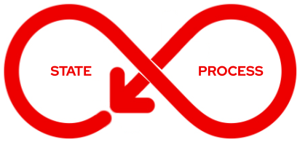
Model, Conditions, Control
Red Hat Infrastructure Standard Adoption Model
Deploy
Monitor
Deliver
Maintain/Destroy
Define
Manage/Test
Review
Configure
Goal: Deliver a pipeline for one or more models
Notes:
[Content Owner]: Paul Armstrong
When dev ops models are discussed they tend to focus a lot on the developer side of the model. The standard operating environment is critical for all those elements that run on top. Developer build systems, orchestration systems, production system creation and testing – all the elements that create the environment on which a devops model runs.
Each Standard Operating Environment model has a set of conditions that include: System content that is required / allowed, system configuration that is required, security configuration, deployment processes, application or runtime configuration, management processes, maintenance process/workflows, monitoring, logging, reporting, revision/recycling/retirement, etc.. and our automation provides the control.

Slide 29
What is a Standard Operating Environment?
Red Hat Infrastructure Standard Adoption Model
A model for the conditions under which we control our machines, systems and processes.
Value is created when we can refactor to a short, discrete list of SOEs using select tools designed to work together in well-defined processes, providing a path to integrated Automation.
A primary goal of the RH-ISAM project is to describe the components used in, and provide automation for, delivering infrastructure to ease and codify the building and maintaining of SOEs for Red Hat Enterprise Linux environments.
Notes:
[Content Owner]: Paul Armstrong
Break it down - the Oxford Dictionary defines these terms:
Standard - a model or norm for comparative evaluation
Operating - the control of the functioning of a machine, system, or process
Environment - the conditions under which an entity (machine, system, process) operates
We can have as many Standard Operating Environments as there are machines, systems, and processes. The value comes when we refactor these models so that we can start from a short discrete list of SOEs and well defined tools and processes that allow us to automate delivery.

Slide 30
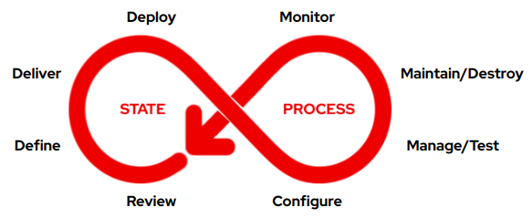


Seeing it as a pipeline model
Red Hat Infrastructure Standard Adoption Model
New Content
New Code, Revisions, Errata,
Vulnerability Data, Configuration Recommendations
Review
Monitor
Define
Deliver
Deploy
Configure
Manage
Maintain
(Publish)
(Promote)
(Provision)
Test
Destroy
Binary Content (rpms, etc..)
Configuration Code
Configuration Templates
Application Code / Containers
A generalized SOE lifecycle
Notes:
[Content Owner]: Paul Armstrong
Without Animations
When dev ops models are discussed they tend to focus a lot on the developer side of the model. The standard operating environment is critical for all those elements that run on top. Developer build systems, orchestration systems, production system creation and testing – all the elements that create the environment on which a devops model runs.
Each Standard Operating Environment model has a set of conditions that include: System content that is required / allowed, system configuration that is required, security configuration, deployment processes, application or runtime configuration, management processes, maintenance process/workflows, monitoring, logging, reporting, revision/recycling/retirement, etc..

Slide 31
Seeing it as a series of pipeline models
Red Hat Infrastructure Standard Adoption Model
New Content
Development
We connect Lifecycle Environments into a path and we promote our artifacts along that path
Rev
Mon
Def
Del
Dep
Con
Man
Main
Automated Delivery
Test
Dest
Binary Content (rpms, etc..)
Configuration Code
Configuration Templates
Application Code / Containers
New Content
Qualification
Rev
Mon
Feedback
Test Results
Error Reports
Dep
Con
Man
Main
Test
Dest
next…
Binary Content (rpms, etc..)
Configuration Code
Configuration Templates
Application Code / Containers
New Content
Notes:
[Content Owner]: Paul Armstrong
When dev ops models are discussed they tend to focus a lot on the developer side of the model. The standard operating environment is critical for all those elements that run on top. Developer build systems, orchestration systems, production system creation and testing – all the elements that create the environment on which a devops model runs.
Each Standard Operating Environment model has a set of conditions that include: System content that is required / allowed, system configuration that is required, security configuration, deployment processes, application or runtime configuration, management processes, maintenance process/workflows, monitoring, logging, reporting, revision/recycling/retirement, etc..

Slide 32
Red Hat Infrastructure Standard Adoption Model
Define
Deliver
Deploy
Notes:
[Content Owner]: Paul Armstrong
Part of the state of the system is the content that is available to the system.
What software is able to be deployed and when.
What lifecycle does that content traverse.
Using Satellite we can define that content quite cleanly.

Slide 33




Red Hat Infrastructure Standard Adoption Model
Content Management
Lifecycle Management
Host Content Management
Retirement Lifecycle
Secure Content Distribution
Production Lifecycle
Production Servers
Qualification Lifecycle
QA Servers
Content
Filtering
Development Lifecycle
Development Servers
Version 1
Other Dev Content
Standard Image Defn
Version 1
Standard Image Defn
Standard Image Defn
Content Baseline
Content Access
Content Delivery
Notes:
[Content Owner]: Paul Armstrong
Part of the state of the system is the content that is available to the system.
What software is able to be deployed and when.
What lifecycle does that content traverse.
Using Satellite we can define that content quite cleanly.

Slide 34
Red Hat Infrastructure Standard Adoption Model
Content Management
Lifecycle Management
Host Content Management
Retirement Lifecycle
Secure Content Distribution
Production Lifecycle
Production Servers
Version 1
Qualification Lifecycle
QA Servers
Version 1
Other QA Content
Version 1
Content
Filtering
Version 2
Development Lifecycle
Development Servers
Version 3
Other Dev Content
Standard Image Defn
Version 3
Standard Image Defn
Standard Image Defn
Content Baseline
Content Access
Content Delivery
Notes:
[Content Owner]: Paul Armstrong
Part of the state of the system is the content that is available to the system.
What software is able to be deployed and when.
What lifecycle does that content traverse.
Using Satellite we can define that content quite cleanly.

Slide 35
Red Hat Infrastructure Standard Adoption Model
Content Management
Lifecycle Management
Host Content Management
Retirement Lifecycle
Secure Content Distribution
Version 1
Production Lifecycle
Production Servers
Other Prod
Content
Version 2
Version 3
Qualification Lifecycle
QA Servers
Version 3
Other QA Content
Version 3
Content
Filtering
Version 4
Development Lifecycle
Development Servers
Version 5
Other Dev Content
Standard Image Defn
Version 5
Standard Image Defn
Standard Image Defn
Content Baseline
Content Access
Content Delivery
Notes:
[Content Owner]: Paul Armstrong
Part of the state of the system is the content that is available to the system.
What software is able to be deployed and when.
What lifecycle does that content traverse.
Using Satellite we can define that content quite cleanly.

Slide 36
Red Hat Infrastructure Standard Adoption Model
Content Management
Lifecycle Management
Host Content Management
Retirement Lifecycle
SOE_RHEL8
v21.0
2022-05
Production Lifecycle
Production Servers
RHEL 9 BaseOS
RHEL 9 AppStream
Custom Repo
Other Content Views
Library
SOE_RHEL8
v22.0
2022-06
SOE_RHEL8
v22.0
2022-06
RHEL 8 BaseOS
RHEL 8 AppStream
Satellite Tools
37242 Packages
3326 Errata
Qualification Lifecycle
QA Servers
SOE_RHEL8
v23.0
2022-07
Other Content Views
EPEL
RHEL 8 Extras
MS SQL Server 2019
All RPMs NO Errata
SOE_RHEL8
v24.0
2022-07
Include
Filters
SOE_RHEL8
v24.0
2022-08
All Streams
No Errata
37331 Packages
3337 Errata
Development Lifecycle
Development Servers
All Errata by
Date
SOE_RHEL8
v25.0
2022-09
Other Content Views
No Firefox
Exclude
Filters
37617 Packages
3371 Errata
SOE_RHEL8
v25.0
2022-08
SOE_RHEL8
Notes:
[Content Owner]: Paul Armstrong

Slide 37
Red Hat Infrastructure Standard Adoption Model
Content Management
Lifecycle Management
Host Content Management
Retirement Lifecycle
Production Lifecycle
Production Servers
Perf Tools RPMs
JBoss Files
Maven Files
Other Content Views
SOE_JAVA_1
Composite
Version 1
SOE_JAVA_1
v1.0
2022-06
SOE_RHEL8
CV
Java App 1 CV
Qualification Lifecycle
QA Servers
Other Content Views
SOE_JAVA_1
Composite
Version 2
SOE_JAVA_1
Composite
SOE_JAVA_1
v2.0
2022-07
JAVA_1
RHEL8
Development Lifecycle
Development Servers
Other Content Views
SOE_JAVA_1
v3.0
2022-08
SOE_JAVA_1
Composite
Version 3
Notes:
[Content Owner]: Paul Armstrong

Slide 38
A Standard Operating Environment Example
Red Hat Infrastructure Standard Adoption Model
An examination of a demonstration environment defined, delivered, deployed and tested using the RH-ISAM…
moving from definition of the environment to implementation of the environment…
Notes:
[Content Owner]: Paul Armstrong

Slide 39
Remember…
Model, Conditions, Control
Red Hat Infrastructure Standard Adoption Model
Deploy
Monitor
Deliver
Maintain/Destroy
Define
Manage/Test
Review
Configure
Goal: Deliver a pipeline for one or more models
Notes:
[Content Owner]: Paul Armstrong
When dev ops models are discussed they tend to focus a lot on the developer side of the model. The standard operating environment is critical for all those elements that run on top. Developer build systems, orchestration systems, production system creation and testing – all the elements that create the environment on which a devops model runs.
Each Standard Operating Environment model has a set of conditions that include: System content that is required / allowed, system configuration that is required, security configuration, deployment processes, application or runtime configuration, management processes, maintenance process/workflows, monitoring, logging, reporting, revision/recycling/retirement, etc..

Slide 40
Seeing it as a pipeline
Red Hat Infrastructure Standard Adoption Model
New Content
New Code, Revisions, Errata,
Vulnerability Data, Configuration Recommendations
Review
Monitor
Define
Deliver
Deploy
Configure
Manage
Maintain
(Publish)
(Promote)
(Provision)
Test
Destroy
Binary Content (rpms, etc..)
Configuration Code
Configuration Templates
Application Code / Containers
A generalized SOE lifecycle
Notes:
[Content Owner]: Paul Armstrong
With Animations
When dev ops models are discussed they tend to focus a lot on the developer side of the model. The standard operating environment is critical for all those elements that run on top. Developer build systems, orchestration systems, production system creation and testing – all the elements that create the environment on which a devops model runs.
Each Standard Operating Environment model has a set of conditions that include: System content that is required / allowed, system configuration that is required, security configuration, deployment processes, application or runtime configuration, management processes, maintenance process/workflows, monitoring, logging, reporting, revision/recycling/retirement, etc..

Slide 41
Seeing it as a series of pipelines
Red Hat Infrastructure Standard Adoption Model
New Content
Development
We connect Lifecycle Environments into a path and we promote our artifacts along that path
Rev
Mon
Def
Del
Dep
Con
Man
Main
Automated Delivery
Test
Dest
Binary Content (rpms, etc..)
Configuration Code
Configuration Templates
Application Code / Containers
New Content
Qualification
Rev
Mon
Feedback
Test Results
Error Reports
Dep
Con
Man
Main
Test
Dest
next…
Binary Content (rpms, etc..)
Configuration Code
Configuration Templates
Application Code / Containers
New Content
Notes:
[Content Owner]: Paul Armstrong
When dev ops models are discussed they tend to focus a lot on the developer side of the model. The standard operating environment is critical for all those elements that run on top. Developer build systems, orchestration systems, production system creation and testing – all the elements that create the environment on which a devops model runs.
Each Standard Operating Environment model has a set of conditions that include: System content that is required / allowed, system configuration that is required, security configuration, deployment processes, application or runtime configuration, management processes, maintenance process/workflows, monitoring, logging, reporting, revision/recycling/retirement, etc..

Slide 42
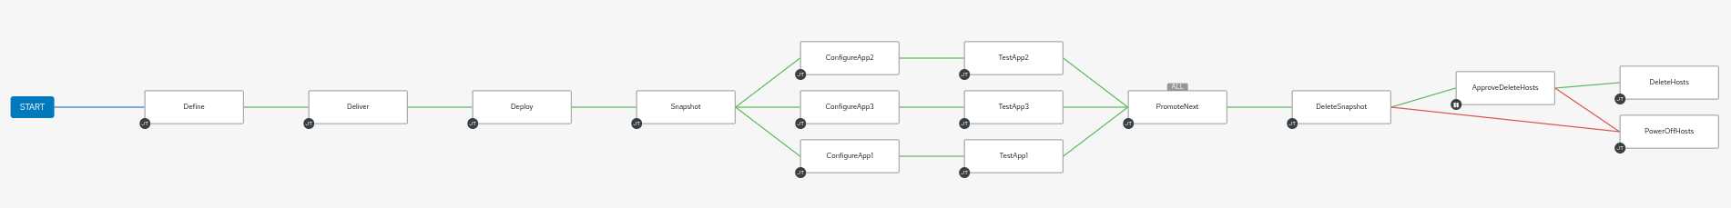
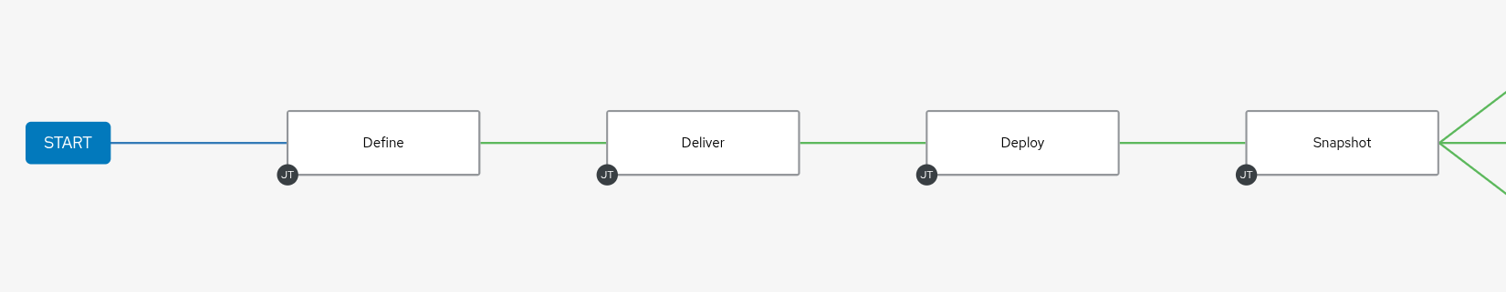
Automating SOE Delivery and Testing Pipeline
Red Hat Infrastructure Standard Adoption Model
Update Errata Filter end date and Publish
[Define]
Promote CVs and CCVs to Dev
[Deliver]
Build Test Systems from Host Groups
[Deploy]
Snapshots for Future Tests if Necessary
Notes:
[Content Owner]: Paul Armstrong

Slide 43
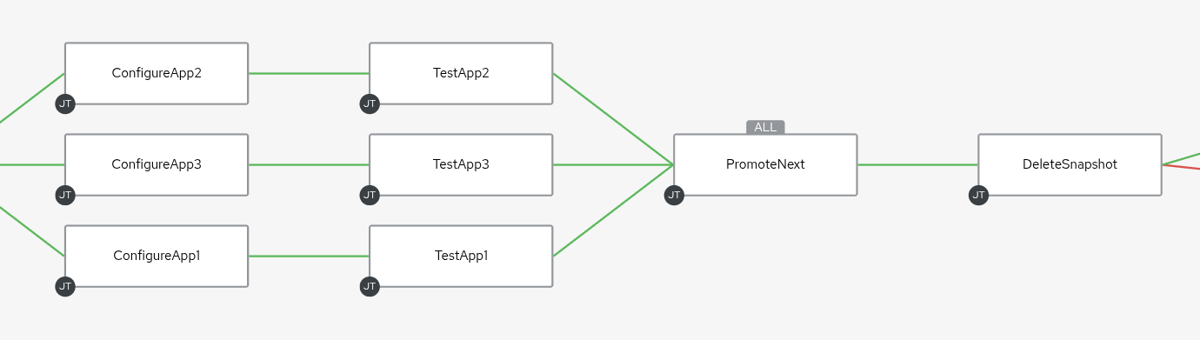
Automating SOE Delivery and Testing Pipeline
Red Hat Infrastructure Standard Adoption Model
Promote CVs and CCVs to QA if ALL tests succeed!
Delete Snapshots
[Destroy]
Not Shown:
On Failure Page OnCall Automation Admin
Install/Configure Application
[Configure]
Test Application
[Test]
Notes:
[Content Owner]: Paul Armstrong

Slide 44
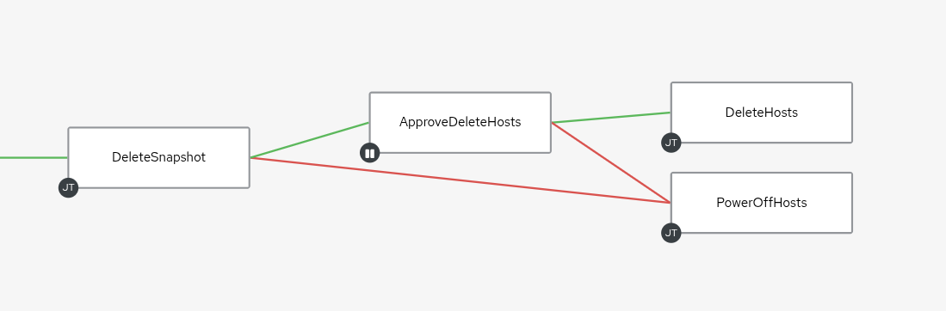
Automating SOE Delivery and Testing Pipeline
Red Hat Infrastructure Standard Adoption Model
Cleanup
Alternately, we can have an Approval Action on deleting or reverting the snaphot
Power Off for further analysis
[Review]
Delete Snapshots
[Destroy]
Approval Action
[Review]
Notes:
[Content Owner]: Paul Armstrong

Slide 45
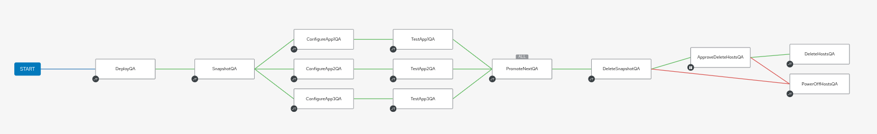
Automating SOE Delivery and Testing Pipeline Flow
Red Hat Infrastructure Standard Adoption Model
Automated Delivery
QUALIFICATION
Notes:
[Content Owner]: Paul Armstrong

Slide 46
Remember: Seeing it as a series of pipelines
Red Hat Infrastructure Standard Adoption Model
New Content
Development
Rev
Mon
Def
Del
Dep
Con
Man
Main
Automated Delivery
Test
Dest
Binary Content (rpms, etc..)
Configuration Code
Configuration Templates
Application Code / Containers
New Content
Qualification
Rev
Mon
Feedback
Test Results
Error Reports
Dep
Con
Man
Main
Test
Dest
next…
Binary Content (rpms, etc..)
Configuration Code
Configuration Templates
Application Code / Containers
New Content
Notes:
[Content Owner]: Paul Armstrong
Including slide again as a reminder of the overall pipeline flow, which then transitions into the next slide, where the series of pipelines is showcased via chained AAP2 workflow templates with feedback loops/error corrections

Slide 47
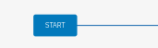
Automating SOE Delivery and Testing Pipeline Flow
via chained Ansible Automation Platform workflow templates incorporating feedback loops
Red Hat Infrastructure Standard Adoption Model
Automated Delivery
DEVELOPMENT
QUALIFICATION
NEXT
Notes:
[Content Owner]: Paul Armstrong

Slide 48
Patching
Red Hat Infrastructure Standard Adoption Model
Notes:
[Content Owner]: Paul Armstrong

Slide 49
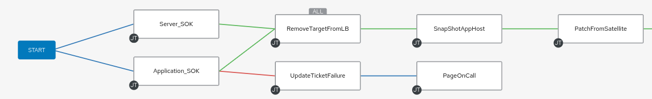
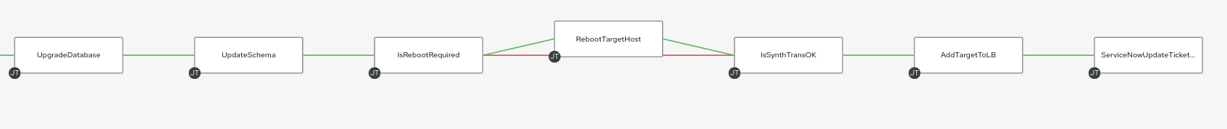
Automating SOE Patching Operations
Red Hat Infrastructure Standard Adoption Model
A Long workflow to patch a set of systems… let’s zoom in
Notes:
[Content Owner]: Paul Armstrong

Slide 50
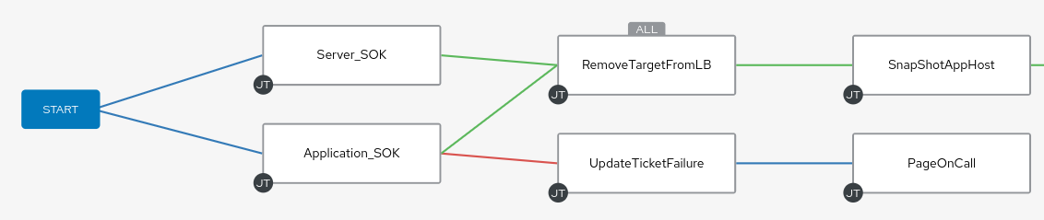
Automating SOE Patching Operations
Red Hat Infrastructure Standard Adoption Model
This section would be attached to each node “On Failure” but the links are removed for clarity.
Notes:
[Content Owner]: Paul Armstrong

Slide 51
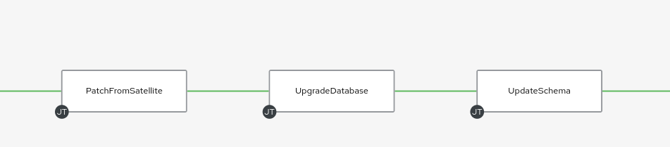
Automating SOE Patching Operations
Red Hat Infrastructure Standard Adoption Model
This section runs our patch process. Patch the server. Upgrade DB software. Update Schema.
Notes:
[Content Owner]: Paul Armstrong

Slide 52
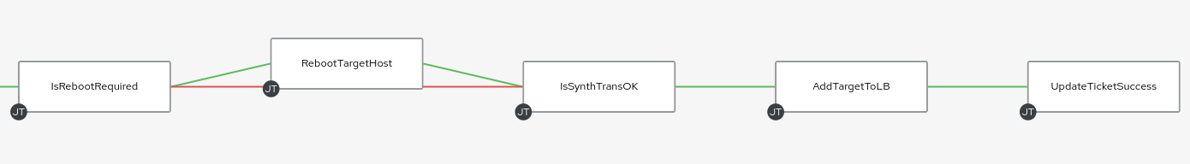
Automating SOE Patching Operations
Red Hat Infrastructure Standard Adoption Model
Reboot and Test. Add it back to the group… Rinse, Repeat with the next node.
Notes:
[Content Owner]: Paul Armstrong

Slide 53
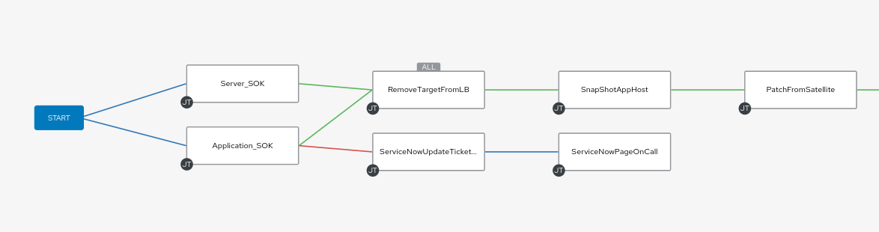
Automating SOE Patching Operations
Red Hat Infrastructure Standard Adoption Model
Notes:
[Content Owner]: Paul Armstrong

Slide 54
Red Hat Infrastructure Review
Red Hat Infrastructure Standard Adoption Model
Notes:
[Content Owner]: Paul Armstrong

Slide 55

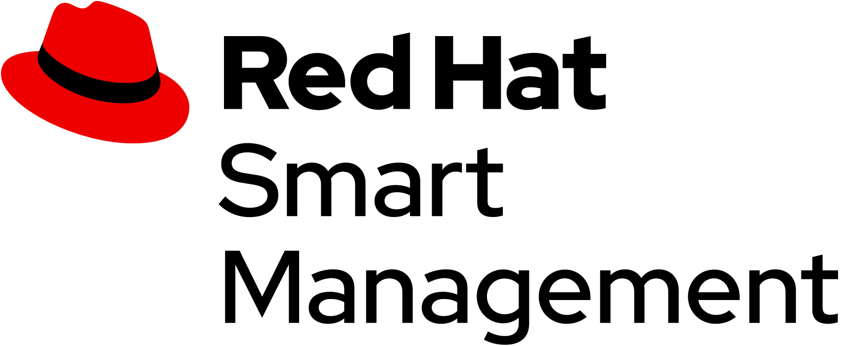
Red Hat Management Portfolio
Red Hat Infrastructure Standard Adoption Model
Identity
AUTOMATION FOR EVERYONE
Simple, Powerful, Agentless
Cross Platform
Systems, Network, Storage, Cloud
Human Readable
PREVENT CRITICAL ISSUES BEFORE THEY OCCUR
Continuous Insights
Verified Knowledge
Proactive Resolution
Included with Red Hat Enterprise Linux.
FLEXIBILITY TO MANAGE RED HAT ENTERPRISE LINUX
Secure software supply chain and content lifecycle on-premise or in the cloud with Satellite and Red Hat Hybrid Cloud Console
MANAGE LINUX IDENTITY AND POLICY
Single Sign On, sudoers, RBAC, HBAC, SELinux Policy, ID mapping, Native AD Integration.
Included with Red Hat Enterprise Linux.
Notes:
[Content Owner]: Paul Armstrong
Note: The product Icons may appear odd on your screen but display properly in presentation mode

Slide 56







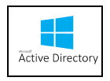





1,000+
1,000+
Applications
Infrastructure
Infrastructure
Services
Infrastructure
Tools
Lifecycle
Compliance
Core services
DNS
IPAM
Automation
TIME
etc..
Configuration
Security/SSO
Notes:
How do we help you win Edge deals? Our new DCS SKUs.
Our approach to the Edge market is “Run any workload, on any footprint, in any location.”
This approach is supported by the view (or fact) that Edge is essentially the decentralization & distribution of compute/storage/networking (which are the core functions of a data center) to remote locations to enable faster decisions and other benefits. With our strong position in the data center w/RHEL and Openshift, this makes sense.
Our traditional business is in the core data center, with low volumes and high performance.
Edge solutions are distributed computing outside the core data center.
The further you go from the data center, volumes are higher, performance requirements are lower, and pricing pressure increases.
For Edge we are now providing up to (depending on the product & fit) 3 new SKUs for each of our existing core products → these are the 3 DCS tiers (or use cases) shown in the graphic.
They are intended for use specifically in the 3 Use Cases, which are now defined in our Appendix 1 EULA.
As a result, they have strict guidelines for use that all Red Hat and partner sales organizations need to follow to remain compliant and/or ensure their customers remain compliant.
NOTE: the volumes noted are cumulative volumes over 3 years

Slide 57
Red Hat Infrastructure Standard Adoption Model
Where you want to be
Pilot
Discovery
Create and build modernisation paths
Deploy automation tools
Design and deploy SOE
Test modernisation of workloads Use side by side comparisons, use dark launches, test deployments
Define the factory
Define day 2 operations and other standards
Why is this important?
Who will be responsible?
Who will be involved in execution?
What is the task we need to execute?
What are target applications?
Navigate
Scale
Review the current environment and integrations, dependencies
Review applications and review systems running these applications, identify and commit to the order of migrations
Analyse where these applications can go to: RHEL, containers, bin, and so on.
High level design for the new RHEL environment, including security model based on HBAC and RBAC and central directory services
Common understanding of the task at hand
Deploy the modernisation factory
Plan for modernisation
Modernize remaining systems
Implement responsibilities
Where you are
Notes:
[Content Owner: Martijn Ten Heuvel]
What is not going to RHEL, but to a container, drifts out of this scope, unless it’s going to OCP Virt.

Slide 58
Thank you!
Thank you
Red Hat is the world’s leading provider of enterprise open source software solutions. Award-winning support, training, and consulting services make
Red Hat a trusted adviser to the Fortune 500.
Notes:
[Content Owner]: Paul Armstrong

Slide 59
Contributors and Reviewers
Red Hat Infrastructure Standard Adoption Model
The following people had a hand in contributing to and/or reviewing this content. *
Name | Email | Title + Org | Role
Paul Armstrong | parmstro@redhat.com | Principal Technical Specialist - RoOT Canada | Contributor
Mike Savage | msavage@redhat.com | Chief Architect - CTO Org: Customer-led Open Innovation | Contributor
Jerone Young | jyoung@redhat.com | Senior Architect - Consulting Services | Reviewer
Martijn ten Heuvel | mtenheuv@redhat.com | Senior Architect - Solutions & Technology Practice | Reviewer
Jelki Dijkstra | jdijkstr@redhat.com | Cloud Architect - Consulting Services | Reviewer
* Contributors and Reviewers - Please add your information and Role to the above table
Notes:
[Content Owner]: Paul Armstrong

Slide 60
Change Log
Red Hat Infrastructure Standard Adoption Model
Version | Committer | Changes | Date
Version 1.3 | parmstro@redhat.com | A long time ago, in a galaxy far, far away… Added Change Log Added QA Pipeline from rhis-builer-aap Updated images for Pipelines for better context | 2025-05-04
* Contributors - Please update change log table and increment version information
Notes:
[Content Owner]: Paul Armstrong

